Slide 1


MODEL

Slide 2
For pre-processing of the dataset we are using “Seq2Seq LSTM” Model in Keras.
Seq2Seq is a type of Encoder-Decoder model using RNN. It can be used as a model for machine interaction and machine translation.
By learning a large number of sequence pairs, this model generates one from the other. More kindly explained, the I/O of Seq2Seq is below:
Input: sentence of text data e.g. “How are you doing?”
Output: sentence of text data as well e.g. “Not so bad.”
For training our seq2seq model, we used (Eng-Hin) Dataset from the ‘manythings.org’ website.
Here one of the pairs from the data set:
Input: Wow!
Output: वाह!

Slide 3
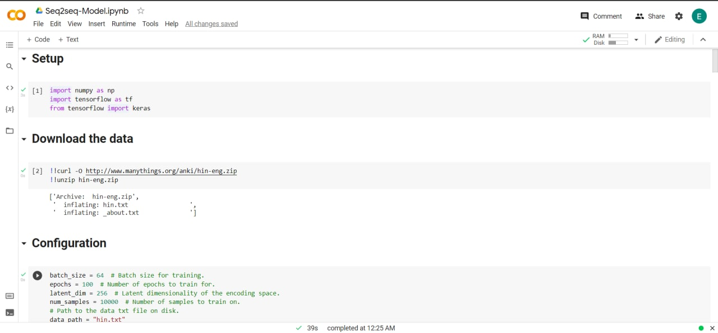

Slide 4
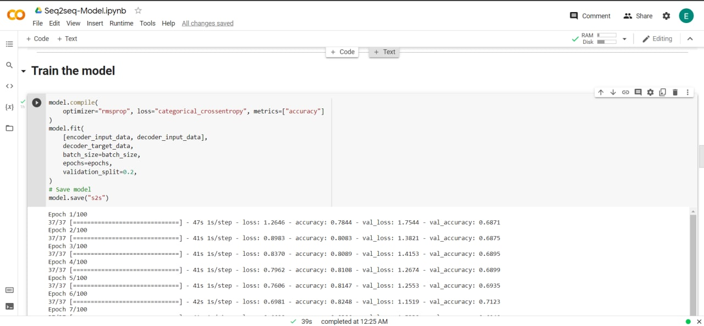

Slide 5
